Slide 1
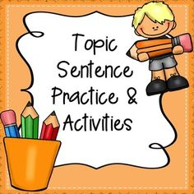
TOPIC SENTENCES

Slide 2
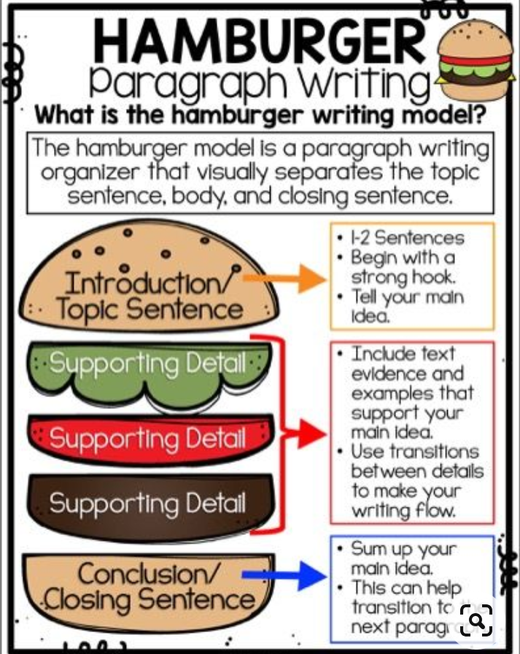

Slide 3
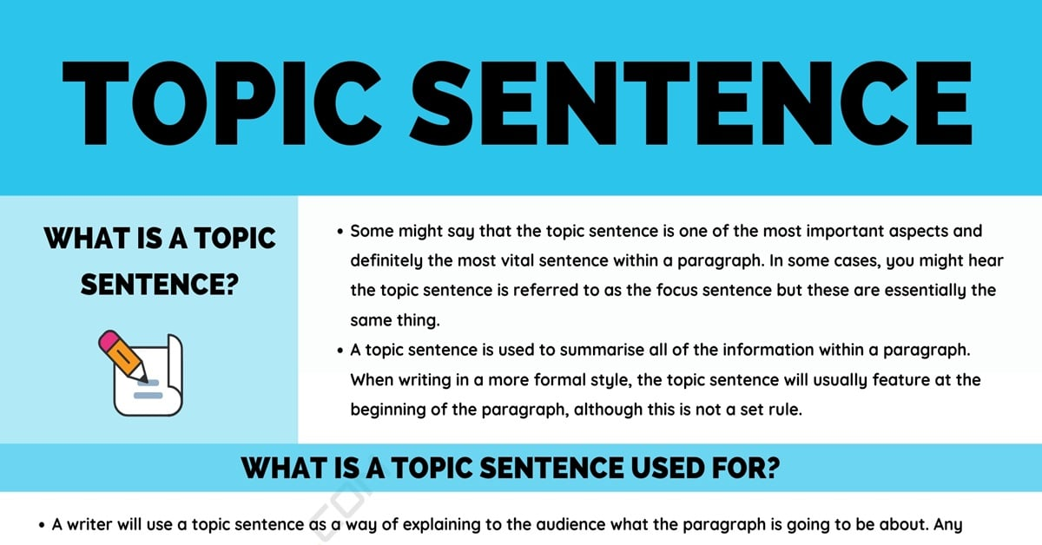

Slide 4
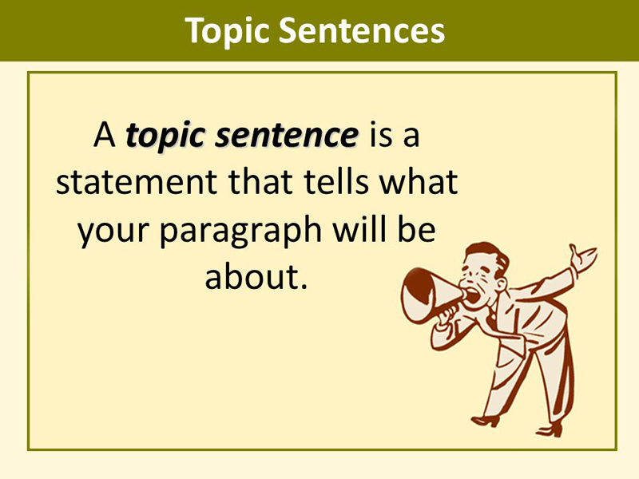
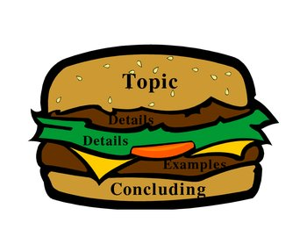
In a well organized paragraph there is a single controlling idea and this is usually given in a sentence called a TOPIC SENTENCE. If the sentence you identified in your own paragraph expresses the main idea of the entire paragraph, it can be considered as a topic sentence.

Slide 5
